Slide 1

5.4 Orthogonality

Slide 2
Introduction
In this topic, we will
  Define orthogonality
  Describe its properties

Slide 3
Orthogonality
Previously, we claimed that for non-zero vectors u and v,
Note that if the inner product is zero,
then cos(θ ) = 0, so
  That is, it would appear that u and v are at right angles
Thus, we will say that if ,
the vectors u and v are orthogonal

Slide 4
Orthogonality
The word orthogonal comes from two Greek words:
ortho for “right”
gon for “angle”
Thus, to be orthogonal is
to have the property of being at right angles
If two vectors u and v are orthogonal, we may just write

Slide 5


Orthogonality
What does it mean for two vectors to be orthogonal?
  Two vectors are orthogonal if neither vector contains any
  information about the other

Slide 6
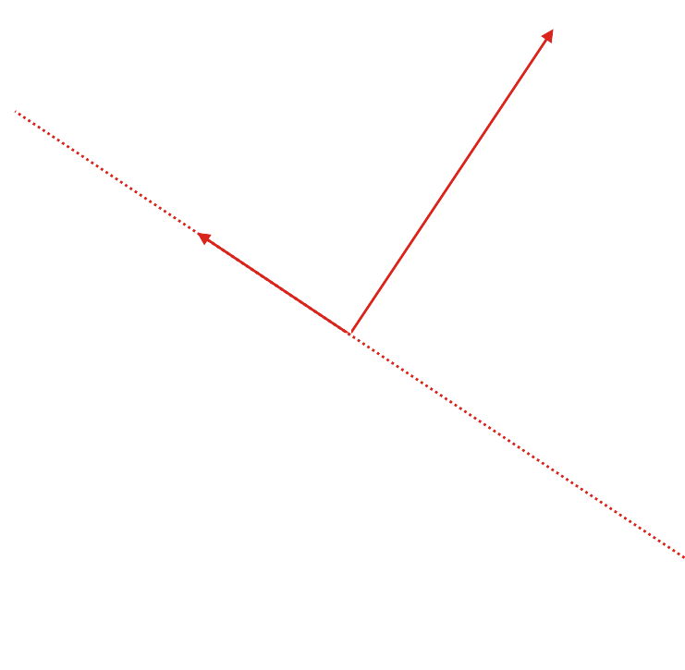
Examples
Consider the following:
  Thus, for these to be orthogonal,
  Thus,
  But this is all scalar multiples

Slide 7
Examples
For two dimensional vectors,
it’s really easy to find an orthogonal vector
  Given ,
  all scalar multiples of are orthogonal to u

Slide 8
The zero vector
Regardless of which vector space V we are in,
if , then
  That is, the zero vector is orthogonal
  to all vectors in that vector space
Theorem
The only vector orthogonal to all vectors is the zero vector.
Proof:
Suppose has the property that for all .
Therefore, .
But if and only if u = 0. ▮

Slide 9
Summary
Following this topic, you now
  Understand the term orthogonal
  Have an idea as to how we will use orthogonality

Slide 10
References
[1] https://en.wikipedia.org/wiki/Orthogonality

Slide 11
Acknowledgments
None so far.

Slide 12



Colophon
These slides were prepared using the Cambria typeface. Mathematical equations use Times New Roman, and source code is presented using Consolas.
The photographs of flowers and a monarch butter appearing on the title slide and accenting the top of each other slide were taken at the Royal Botanical Gardens in October of 2017 by Douglas Wilhelm Harder. Please see
https://www.rbg.ca/
for more information.

Slide 13
Disclaimer
These slides are provided for the ne 112 Linear algebra for nanotechnology engineering course taught at the University of Waterloo. The material in it reflects the authors’ best judgment in light of the information available to them at the time of preparation. Any reliance on these course slides by any party for any other purpose are the responsibility of such parties. The authors accept no responsibility for damages, if any, suffered by any party as a result of decisions made or actions based on these course slides for any other purpose than that for which it was intended.

